Slide 1
Analysis of Shopping Behaviours
Extracting insights from 3,900 customer transactions to drive strategic business growth.

Slide 2
Project Overview
Analyzing transactional data encompassing customer demographics, purchase details, and shopping behaviors across multiple product categories to inform key business decisions.

Slide 3

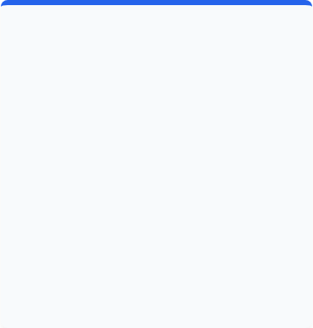
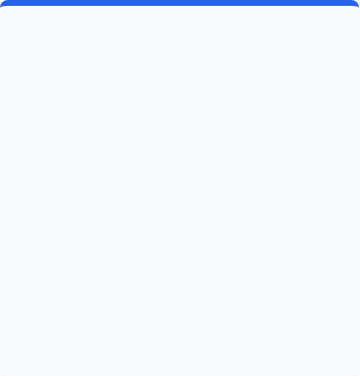



Data Preparation & Engineering
Data Cleaning
Standardization
Feature Engineering
Addressed missing values in the Review Ratings column by using the category median, preventing outlier skew and ensuring robust data consistency.
Renamed variables to snake_case format for enhanced readability. Removed redundant columns (e.g., duplicate promo codes) to optimize the dataset.
Created distinct "Age Groups" (Young Adult to Senior) via quantiles and standardized purchase frequency into a numerical "Days" column for detailed cohort analysis.

Slide 4
Key Dashboard Metrics
Overall Business Pulse
3.8
The dataset represents a strong sample size of nearly 4,000 customers. The average purchase amount stands at $59.76 per transaction.
Customer satisfaction is solid with an average rating of 3.8/5.0, forming a reliable foundation for analyzing long-term purchasing behavior and product success.
Average Review Rating

Slide 5
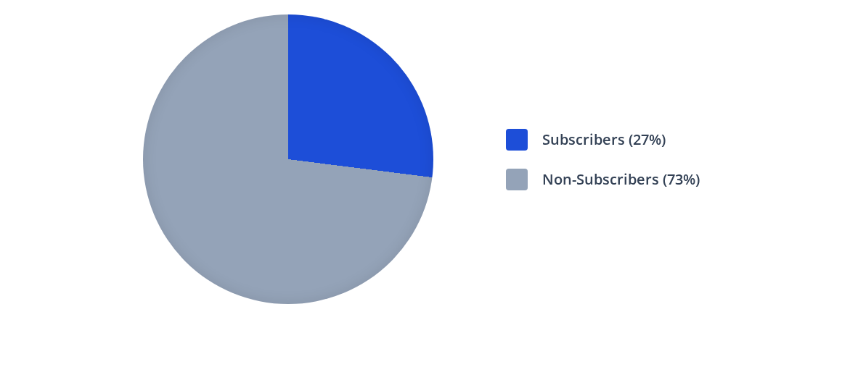
Subscription Status Breakdown
Despite a lower subscriber base (1,053 customers), driving membership remains crucial. Non-subscribers currently account for the majority of the $170,436 total non-subscriber revenue.

Slide 6
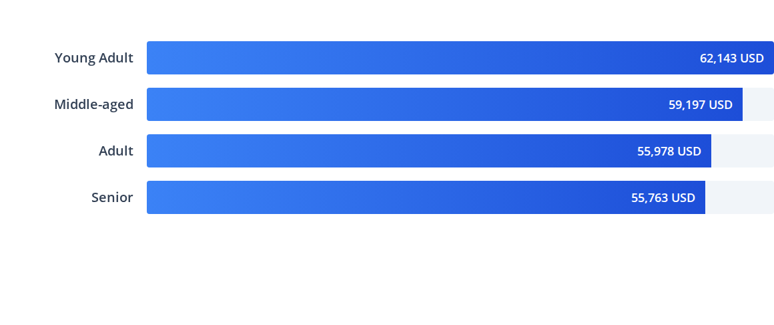
Revenue by Age Group
The "Young Adult" segment is the highest revenue driver, closely followed by the "Middle-aged" cohort, indicating a strong appeal of the product catalog to younger demographics.

Slide 7
Top Performing Products
Category | Top Product | Total Orders | Average Rating
Accessories | Jewelry | 171 | 3.7+
Clothing | Blouse | 171 | 3.7+
Footwear | Sandals | 160 | 3.84
Outerwear | Jacket | 163 | 3.7+
Accessories | Gloves | 140+ | 3.86 (Highest rated)

Slide 8


Customer Loyalty & Shipping
•
Loyalty vs. Subscription: The vast majority of our base (3,116 customers) fall into the "Loyal" segment based on repeat purchases. However, 2,518 repeat buyers remain non-subscribers.
•
High-Spend via Discounts: 839 customers were identified as high-spenders who aggressively utilize discounts, specifically on items like Hats (50% discount rate).
•
Shipping Preferences: Customers using Express Shipping spend an average of $60.48 per order, marginally higher than Standard Shipping users ($58.46).
•
Gender Disparity: Male customers generated significantly more revenue ($157,890) compared to Female customers ($75,191).

Slide 9

Strategic Recommendations
Customer Loyalty Program: Implement targeted incentives to officially migrate the 3,116 repeat buyers into an engaged loyalty tier.
Enhance Subscriptions: Promote premium benefits to increase the current 27% subscriber base, focusing on the 2,518 frequent buyers who have yet to subscribe.
Targeted Marketing: Focus ad spend on the high-revenue Young Adult and Male demographics, while promoting Express shipping upgrades.
Review Discount Policy: Adjust promotional strategies on top-discounted items (like Hats/Sneakers) to balance sales volume with margin control.

Slide 10
Thank You!
We are now open for questions regarding the analysis and strategic recommendations.

Slide 11


Image Sources
https://www.edesk.com/wp-content/uploads/2020/04/eCommerce-packaging.jpg
Source: www.edesk.com
https://images.stockcake.com/public/d/5/6/d56e3a33-8fa6-4b5c-938a-2e97c87df1c6_medium/business-team-analysis-stockcake.jpg
Source: stockcake.com

